Slide 1

Plan Year 2022
Partner Certification and Recertification
For Internal Use Only

Slide 2

Last year we…
01 | Validated 6 Testing Attempts for AHIP
02 | Removed the Humana-portion Test
03 | Certified for all Products
04 | Added the “Get Certified” button on Vantage
Notes:
01 | Validated 6 Testing Attempts for AHIP
02 | Removed the Humana-portion Test
03 | Certified for all Products ---------- no more PDP-only certs, lowering violations when PDP-only agents sold MAPD products
04 | Added the “Get Certified” button on Vantage ---- making cert and recert easier to find.

Slide 3
Partner Channel - Mark these dates on your calendar!
6/11
Enrolling for PY21 Cert closes
6/11-17
PY21 Cert Grace period for previously enrolled agents
17th – AHIP closes
6/21
PY22 AHIP Certification Opens (8:00 AM, EST)
6/24
PY22 NAHU Certification Opens (8:00 AM, EST)
6/29
Humana’s
Certification & Recertification Open (12:00 PM, EST)
10/15
AEP Opens
11/30
Deadline for Partner Agents to Recertify (5:00 PM, EST)
12/7
AEP Closes
Notes:
First, mark your calendar with these dates!

Slide 4

Course Outlines

Slide 5


Partner Field Agent Recertification
Tab for Additional Resources & Downloads
How to complete Humana’s MAPD Recertification
AHIP/NAHU Prior to Test
Introduction to the AHIP or NAHU Medicare Course
2022 AHIP or NAHU Medicare Training
AHIP or NAHU Attestation
Humana Sales and Marketing Compliance
Privacy & Security
Compliance and Ethics
Code of Ethics for Partner Field
Humana Sales and Marketing Guidance
Humana 2022 MAPD/PDP Agent Guidance
Humana 2022 Sales Resources Guide
Humana First Look (Product Information)
Humana Compliance, Process and Marketing Attestations – Partner Field
Wrap –Up
Coronavirus Information
Course Completion / Confirm Eligibility for Sales Materials
Survey – Recertification for Partner Field
How to Order Sales Starter Materials
Order Sales Starter Materials
Note: a select group of State Farm and TruBridge agents will be taking Humana’s CMS Required Training.
DRAFT

Slide 6
Partner Field Initial Certification
Welcome to Humana’s MAPD Certification
AHIP
Attestation to AHIP/NAHU
Introduction to AHIP/NAHU Medicare
AHIP/NAHU course
Attestation to AHIP/NAHU
Compliance
Compliance and Ethics
Code of Ethics
Compliance Knowledge Check
Humana Products
Introductions to Humana Products (Webpage)
First Look
CarePlus Training (completed by FL agents only)
Special Needs Plans
Optional Supplemental Benefits
Prescription Drug Plans
Humana’s Value Commitment
Sales presentation and Tools (Webpage)
10 step process
Prepare
Greet, Visit, & Verify
Needs & Select
Explain
(continued) Sales presentation and Tools (Webpage)
Enroll
  Find a Doctor
  Pharmacy Calculator
  Enrollment tools
  Paper Applications
Wrap Up and Serve
Connecting the Dots
Sales Presentation Knowledge Check
Agent Guidance
Agent Guidance materials
Attestations (3)
Wrap up
Course Completion / Confirm Eligibility for Sales Materials
Survey – Recertification for Partner Field
How to Order Sales Starter Materials
Order Sales Starter Materials
Optional Sales Resources
DRAFT
Tab for Additional Resources & Downloads

Slide 7

Big changes for Plan year 2022!

Slide 8


&
AHIP & NAHU for 2022
Agents will have option between AHIP or NAHU. They must select one and stick with that path.
Notes:
6 test attempts for each.
Although with AHIP’s you have to pay for the second set of 3. With NAHU it’s included.

Slide 9

Comparing AHIP & NAHU
90% or better to pass the test (6 attempts*)
2 hour time limit per test attempt (50 questions)
$125 **
CE Credits not included in the initial cost.
Spanish option available
Major carriers have used it for years
85% or better to pass the test (6 attempts)
2 hour time limit per test attempt (50 questions)
$90**
CE Credits included in the initial cost.
Spanish option is not available
NAHU Medicare Cert Training is New. Humana is one of the only major carries offering it currently for PY22.
* Additional 3 attempts can be purchased. For PY21 cert-recert less than 1% of agents needed to purchase an additional 3 AHIP test attempts.
** Prices reflect a discount that only applies when agents access AHIP or NAHU via their Humana cert-recert course.
| 9
Notes:
For AHIP, when you’re ready to take the final exam, it will include 50 randomly selected questions and cover all five modules. You’ll have 2 hours to complete each attempt, which should be completed in a single, continuous setting.
The testing approach with NAHU is similar but with some important differences. AHIP has two tests – one covering Medicare and one covering FWA. NAHU just has one test covering content from both Medicare and FWA training and the minimum passing score is 85%.
Agents must maintain integrity when completing the AHIP examination and will not engage in any dishonest behavior, including but not limited to, cheating, having someone test on your behalf, or answer sharing. For Humana’s PY21 cert and recert training, almost all agents passed the AHIP final exam and, as a matter of fact, less than 1% of agents needed more than three attempts to pass, so, really, there is little risk of not passing.

Slide 10

Reminder:
Tests are to be completed in a single, continuous sitting.
Agents must maintain integrity when completing the AHIP or NAHU examination and not engage in any dishonest behavior, like cheating, having someone test on your behalf, or sharing test answers with others.
| 10
Notes:
Tests are to be completed in a single, continuous sitting.
Agents must maintain integrity when completing the AHIP or NAHU examination and not engage in any dishonest behavior, like cheating, having someone test on your behalf, or sharing test answers with others.

Slide 11
More engaging & interactive Ethics & Compliance training with real life scenarios.

Slide 12
The Agent Guidance lesson includes more knowledge checks and scenarios.

Slide 13

AHIP or NAHU:
The agent experience
Notes:
Humana is excited to offer AHIP and NAHU as training options for PY22 certification and recertification. Here we’ll demonstrate how Humana will incorporate AHIP and NAHU.

Slide 14


The Agent Experience – AHIP & NAHU Options
Agents see their required training notification and select the View button.
All screen shots are drafts and subject to change.
| 14

Slide 15
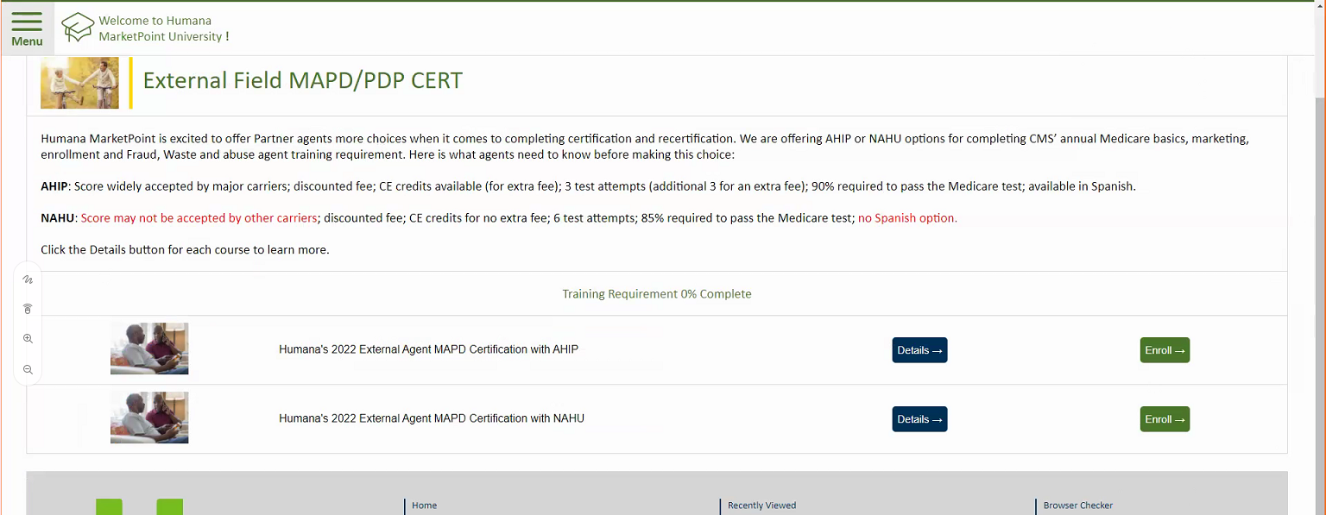


The Agent Experience – AHIP & NAHU Options
Agents land on their cert page which provides details about their AHIP and NAHU options.
Agents will see the two courses – one with AHIP and one with NAHU.
Agents can select Details to learn more about each course.
All screen shots are drafts and subject to change.
| 15

Slide 16
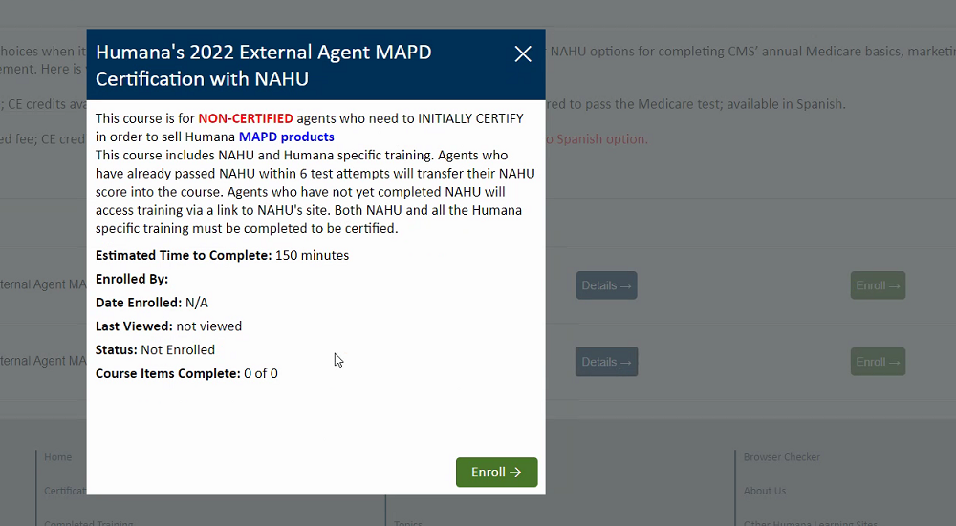
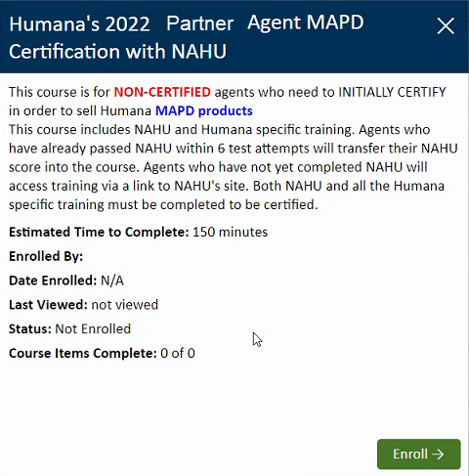
The Agent Experience – Most Career & Exclusive Agents
Cert course details example
All screen shots are drafts and subject to change.
| 16

Slide 17
The Agent Experience – AHIP & NAHU Options
Agents choose their course by selecting the Enroll button.
All screen shots are drafts and subject to change.
| 17

Slide 18
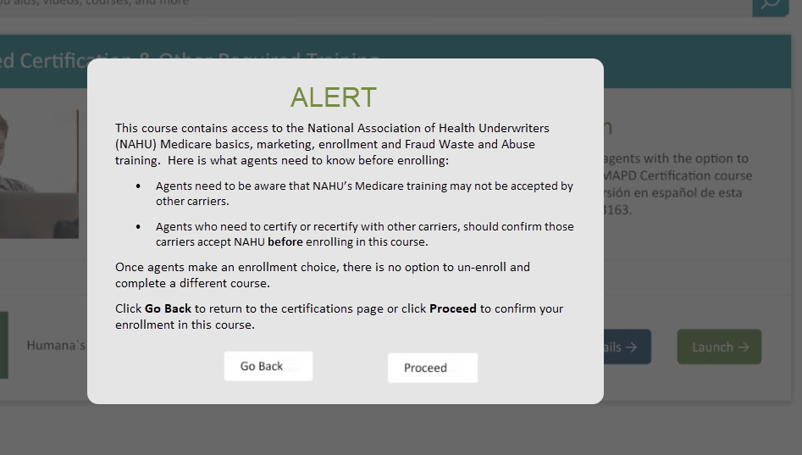
The Agent Experience – AHIP & NAHU Options
Before enrollment in NAHU is completed, agents will receive a pop-up message with more details.
It is vitally important agents understand before they enroll:
NAHU might not be accepted by other carriers and
Once agents enroll in either the AHIP or NAHU course, they must satisfactorily complete that course (no switching)
Go Back cancels the enrollment and returns to the cert page
Proceed confirms the enrollment.
All screen shots are drafts and subject to change.
| 18

Slide 19
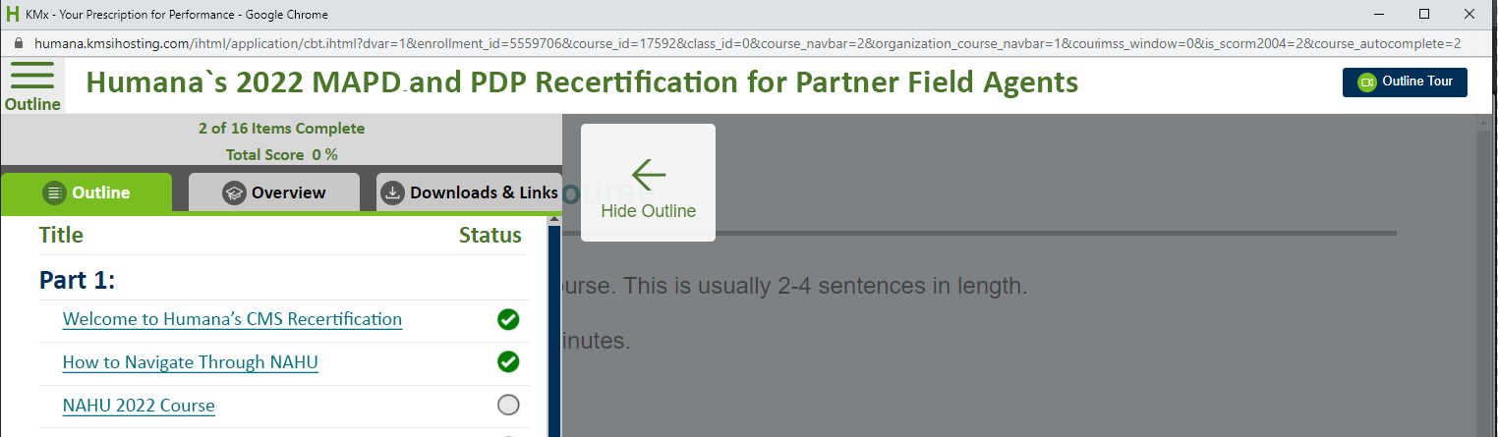
The Agent Experience – AHIP & NAHU Options
Once enrolled agents will see the course outline. The link to NAHU to work the same as how we handle AHIP today. Very similar experience. Agent will click the NAHU course link and be taken to NAHU’s site to create or update their profile and complete the registration and enrollment process.
For privacy reasons, NAHU (and AHIP) can only automatically transfer scores to HMU for agents who are already affiliated with Humana. Affiliation is established once agents have clicked the link from their HMU cert-recert course and logged into NAHU’s site. After affiliating with Humana, agents can then transfer their NAHU score back to HMU.
All screen shots are drafts and subject to change.
| 19

Slide 20
The Agent Experience – AHIP & NAHU Options
How long does Cert and Recert take?
The amount of time required to complete cert or recert varies by learner, but we can give some general estimates of how much time is required to complete training.
Since CMS specifies what topics agents must be trained on, the estimated time to complete NAHU training is similar to AHIP. Agents should expect to spend 3 – 7 hours completing this portion of their cert-recert course.
The Humana specific portion of the Certification course should take up to 6 hours to complete.
The Humana specific portion of the Recertification course should take about 1 - 2 hours to complete.
IMPORTANT: After completing AHIP or NAHU training, agents must complete the rest of their cert or recert course in its entirety. Agents who do not complete the entire course (AHIP or NAHU + Humana specifics), will NOT be certified.
All screen shots are drafts and subject to change.
| 20

Slide 21
Mark your calendars!
Launch is June 29, 2021

Slide 22

Questions?

Slide 23
Plan Year 2022
Partner Certification and Recertification

